Slide 1
Wine Data analysis

Slide 2
Objective:
While the wine industry generally has been very proactive about dealing with climate change, from capturing fermentation carbon to trialling new varieties, this is ultimately a political problem. To find an effective solution for this problem you were asked to help in ETL process.
Do ETL : Extract-Transform-Load some Amazon dataset and find for me
Sales-trend -> month wise , year wise , yearly_month wise
Benefits:
Analyse the sales .
Relationship Between the datasets.
Design the dashboard on Powerbi.

Slide 3
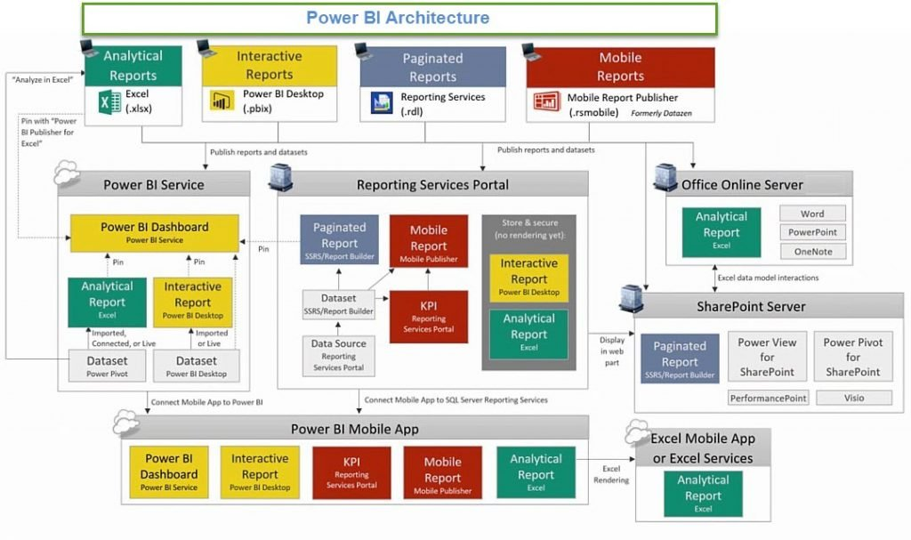
Architecture

Slide 4
Power BI’s integration with R & Python-
Apart from the various visualization advantages that Power BI offers, it also has an amazing out of the box connection capabilities. Power BI can easily integrate with languages like Python, R, and even with DBMS like SQL. This offers increased advantages in terms of functionalities and comes in handy for Data Scientists who are used to working in Python or R. They can directly import the R and Python scripts in the workspace and take advantage of its visualizations which are far more superior than that of these languages.
Power BI & R-
R is a popular statistical language used to perform sophisticated analysis and predictive analytics, such as linear and nonlinear modeling, statistical tests, time-series analysis, classification, clustering, etc. Using Power BI in conjunction with R gives the users access to a rich, ever-expanding collection of statistical analysis and data mining libraries to help them gain deeper insights from their data.

Slide 5
Using Python scripts for visualizing data:
Python has been used for data visualization since years. Libraries like matplotlib are good for getting a sense of the data. Although, when it comes to creating aesthetically pleasing charts quickly and conveniently Python is not very useful. However, when we integrate Python and Power BI, we acquire publication-quality charts. The video below shows us an instance of displaying the sales with respect to the Week ID using Python.
Integrating Python with Power BI:
Python is often used for data visualization using libraries like Matplotlib , Sea born, Gleam, Plotly , etc. Power BI is a platform where we can integrate and enhance Python visualizations.
Requirements: Install Python and other necessary libraries and packages that you will require in your system

Slide 6
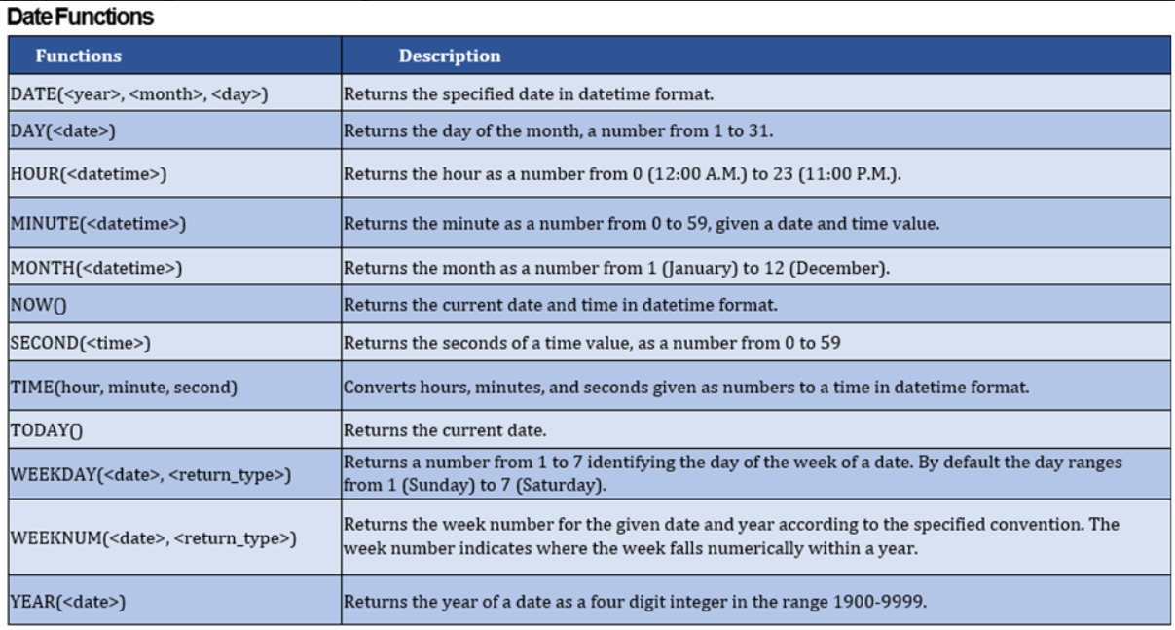
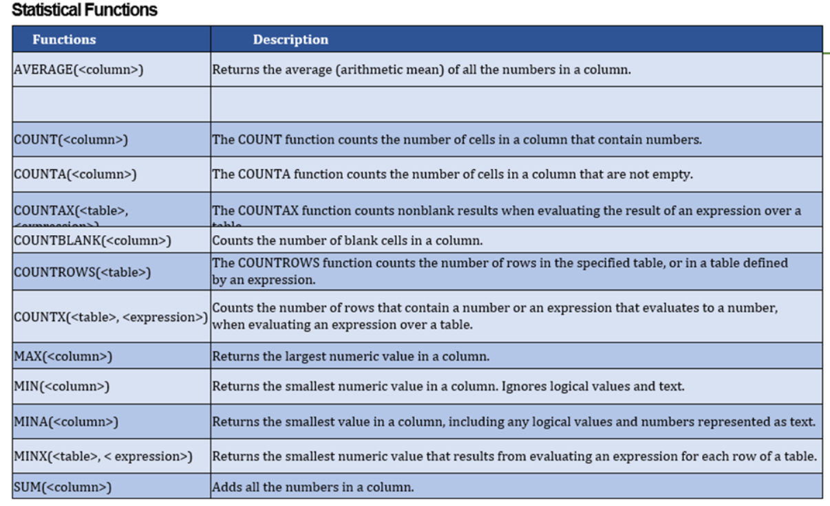
Understanding DAX Functions and creating measures-

Slide 7
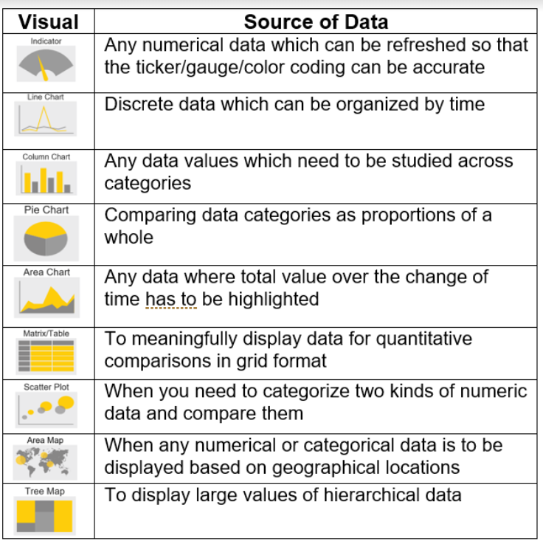
Different ways to visualize data in Power BI
Power BI comes with several visuals, including pie charts, maps, and bar charts. It also includes complicated models such as funnels, gauge charts, a cascade, and a variety of other elements. The default visualization icons are shown in the figure below.
Let’s check out the below table which can help us incorporate some basic visualizations into our report which we will publish-

Slide 8
Q & A:
1. What is Power BI?
Power BI is a business analytics tool developed by Microsoft that helps you turn multiple unrelated data sources into valuable and interactive insights. These data may be in the form of an Excel spreadsheet or cloud-based/on-premises hybrid data warehouses. You can easily connect to all your data sources and share the insights with anyone.
2. Why should we use Power BI?
Because Power BI provides an easy way for anyone, including non-technical people, to connect, change, and visualize their raw business data from many different sources and turn it into valuable data that makes it easy to make smart business decisions.

Slide 9
3. What is Power Pivot?
Power Pivot is an add-on provided by Microsoft for Excel since 2010. Power Pivot was designed to extend the analytical capabilities and services of Microsoft Excel.
4. What is Power Query?
Power Query is a business intelligence tool designed by Microsoft for Excel. Power Query allows you to import data from various data sources and will enable you to clean, transform and reshape your data as per the requirements. Power Query allows you to write your query once and then run it with a simple refresh.
5. What is DAX?
DAX stands for Data Analysis Expressions. It's a collection of functions, operators, and constants used in formulas to calculate and return values. In other words, it helps you create new info from data you already have.

Slide 10
6. What are Filters in Power BI?
The term "Filter" is self-explanatory. Filters are mathematical and logical conditions applied to data to filter out essential information in rows and columns. The following are the variety of filters available in Power BI:
Manual filters
Auto filters
Include/Exclude filters
Drill-down filters
Cross Drill filters
Drillthrough filters
Drillthrough filters
URL filters–transient
Pass-Through filters

Slide 11
7. What are Custom Visuals in Power BI?
Custom Visuals are like any other visualizations, generated using Power BI. The only difference is that it developes the custom visuals using a custom SDK. The languages like JQuery and JavaScript are used to create custom visuals in Power BI.
8. What is GetData in Power BI?
Get Data is a simple icon on Power BI used to import data from the source.
9. Mention some advantages of Power BI.
Some of the advantages of using Power BI:
It helps build an interactable data visualization in data centers
It allows users to transform data into visuals and share them with anyone
It establishes a connection for Excel queries and dashboards for fast analysis
It provides quick and accurate solutions
It enables users to perform queries on reports using simple English words

